Slide 1
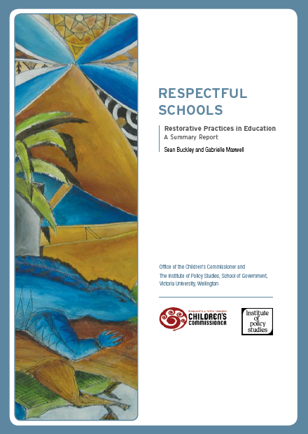
Respectful Schools
Restorative Practices in Education
A Summary Report
Sean Buckley and Gabrielle Maxwell
Published in January 2007
http://www.occ.org.nz/__data/assets/pdf_file/0011/3314/OCC_Respectful_Schools_Report.pdf

Slide 2
The research was commissioned
by New Zealand’s Children’s
Commissioner and carried out by
the Institute of Policy Studies,
Victoria University.

Slide 3
The purpose:
To assess the “growing interest in developing practices based on restorative justice to respond to the behaviour problems and under-achievement of students in schools.”
To provide a summary for school principals, boards of trustees and parents.
The research was conducted in five High Schools, but the results apply to Primary and Intermediate schools.

Slide 4
The Outcome of the report:
Disciplinary strategies became more constructive.
Students with difficulties were better supported.
Teachers, students and parents began to build better relationships rather than dealing with situations through confrontation.
Students developed a sense of belonging which in-turn strengthened their pride in their strengths and successes.
Parents developed more positive relationships with the schools.
Diversity was recognised and accepted by students and teachers.
NCEA results in the 5 case schools showed gains.
But more important there was an improvement in the atmosphere at the 5 schools.

